Slide 1
Smart Bin Project
Ivan Naumovski
Martino Secchi
Pervasive Computing Project 2016

Slide 2
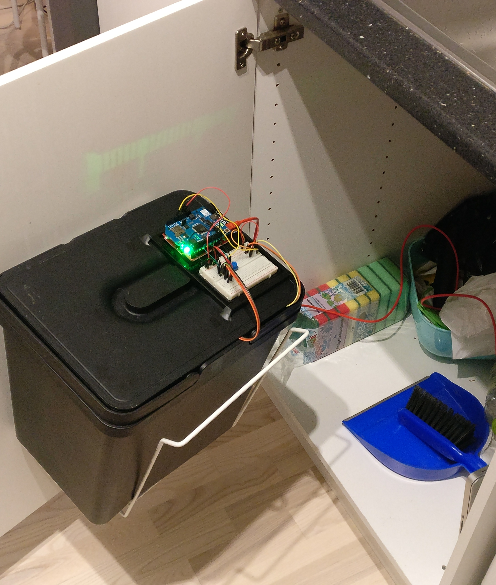
Smart Bin
An extension to a normal trash bin can measure and transmit your trash status.
Odor detection
Trash level
Centralised controller
Cloud based data service

Slide 3
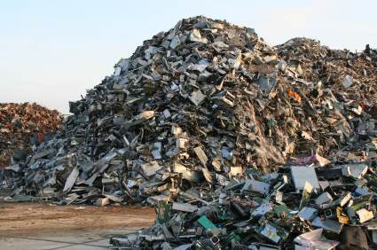
Traditional Approach
Amount of trash
Current systems use technologies such as:
Physical sensing: Weight data or distance from the top.
Tracking: Keep track of every item thrown out (RFID, barcodes).

Slide 4
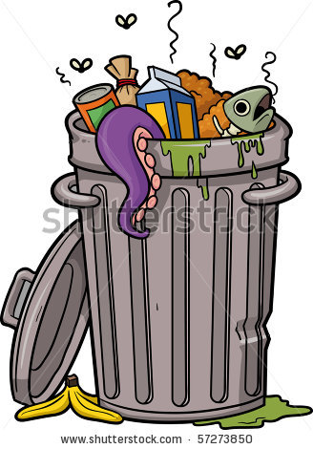
Concept
Our system is able to detect smell levels emitting from the trash, to ultimately improve air quality especially in indoor environments.

Slide 5
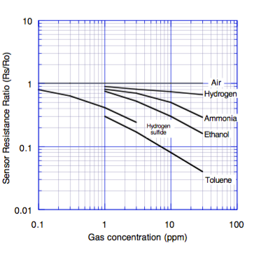
Odor detection
Machines can’t sense smell, so how does it work?
Decomposition of organic materials produces gases.
In particular, “smelly” gases that are a byproduct of protein decomposition are:
hydrogen sulphide, amines, methane, short chain alcohols (methanol, ethanol), …

Slide 6
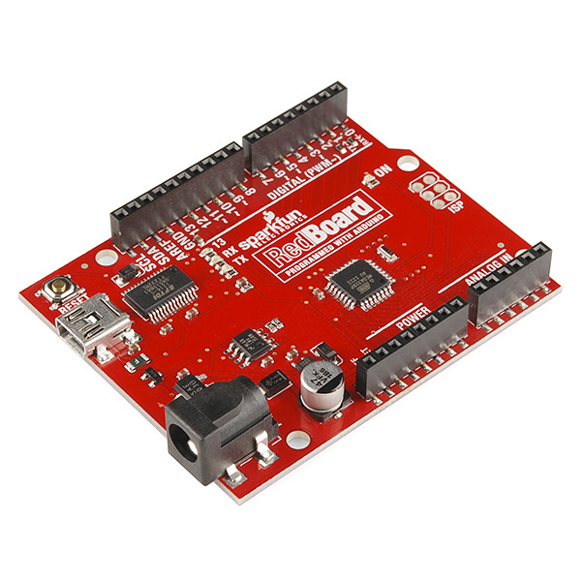
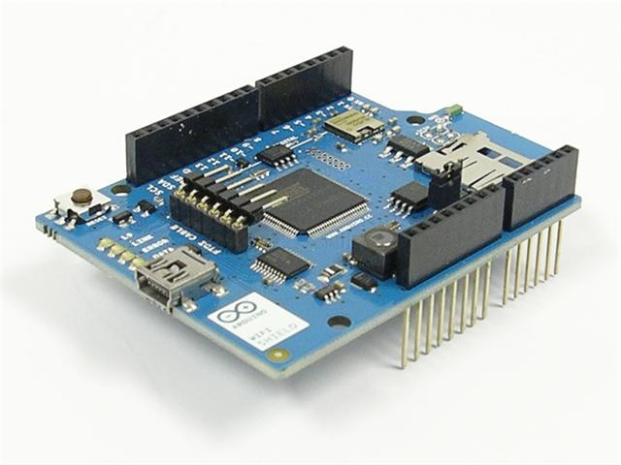
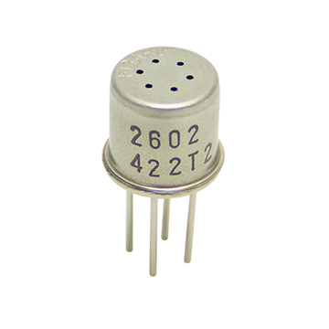
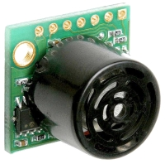
The device Components

Slide 7
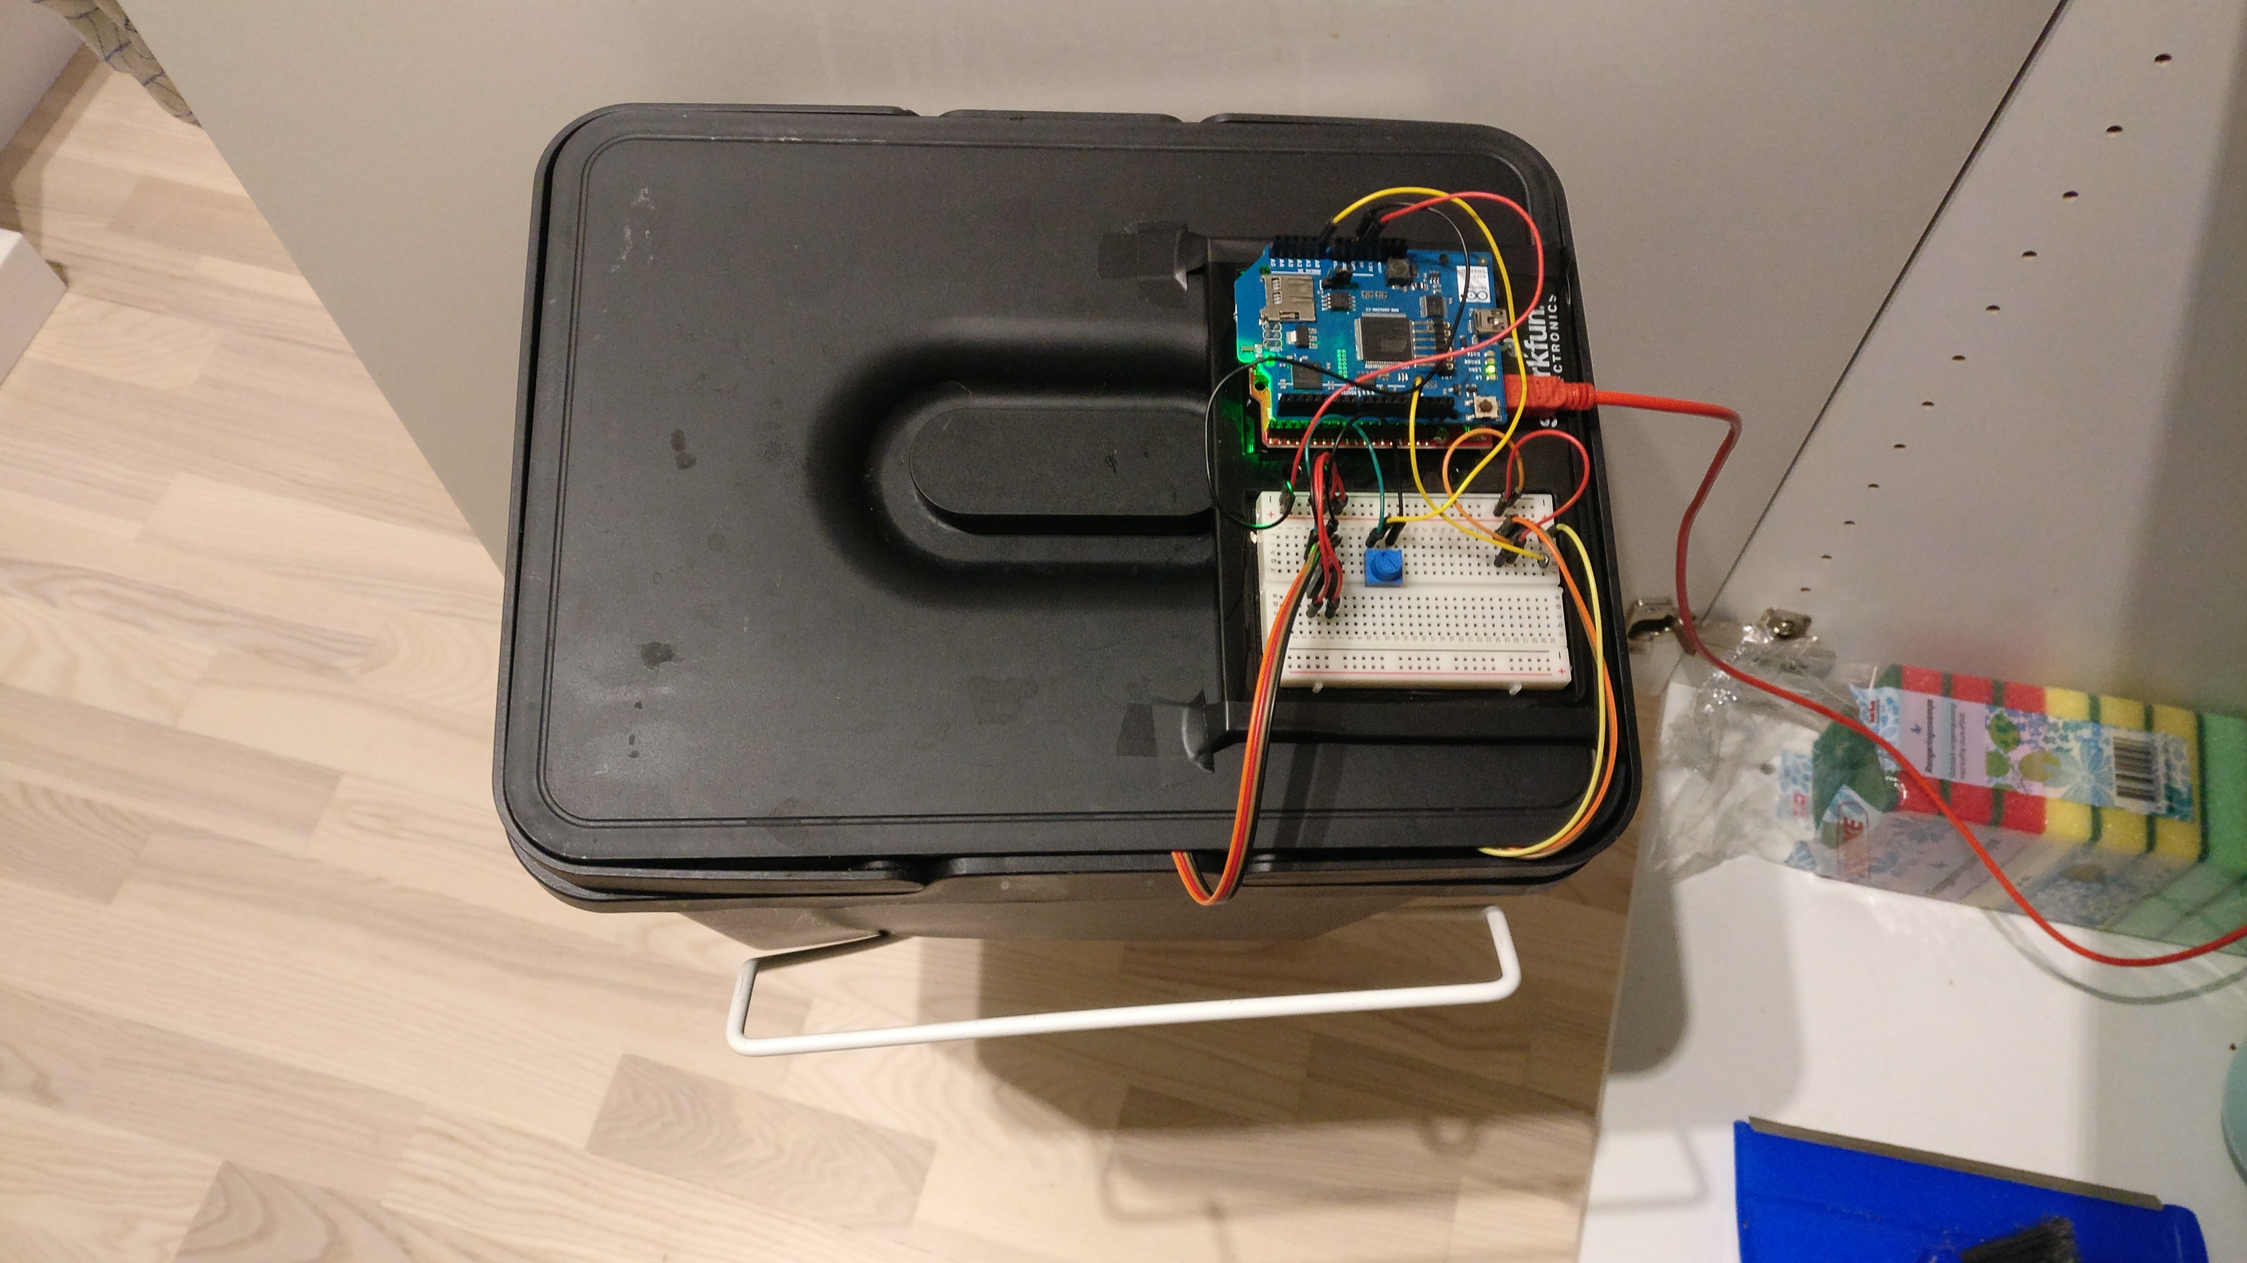
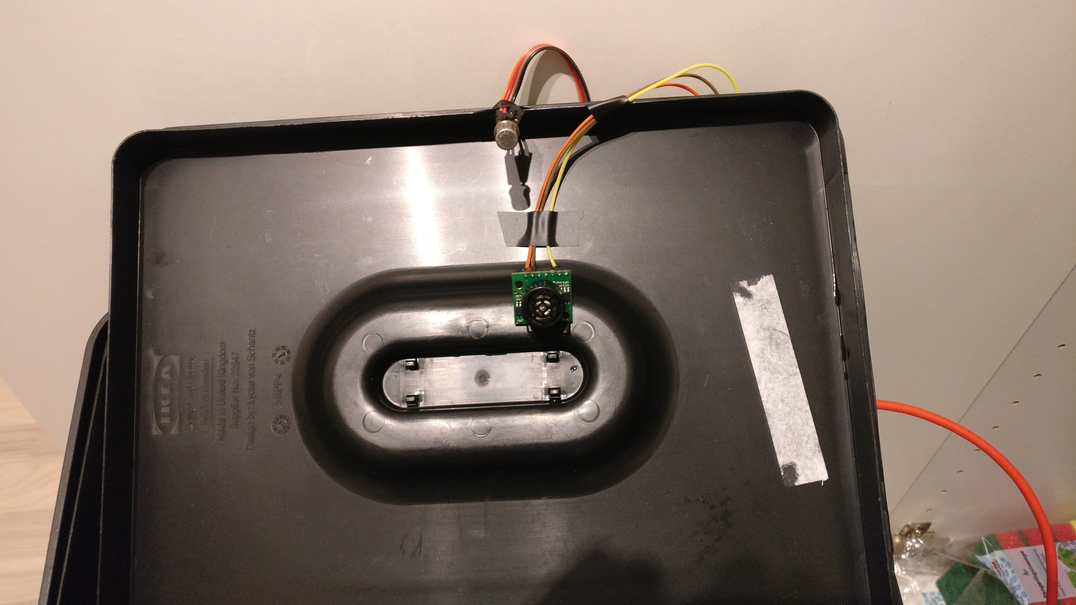
The device Prototype
Top down view:
Device has been mounted on the lid.
Inside view:
Sensors have been placed on the inside of the bin.

Slide 8
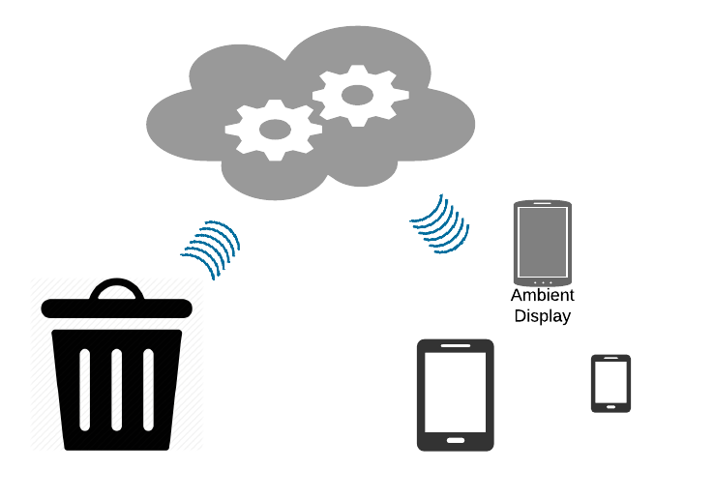
Cloud-based Architecture
Collected information is sent
directly from the bin to the
cloud
Information is made accessible through the cloud.
Clients can use this data to provide experiences.
An ambient display or smartphone monitoring app.

Slide 9
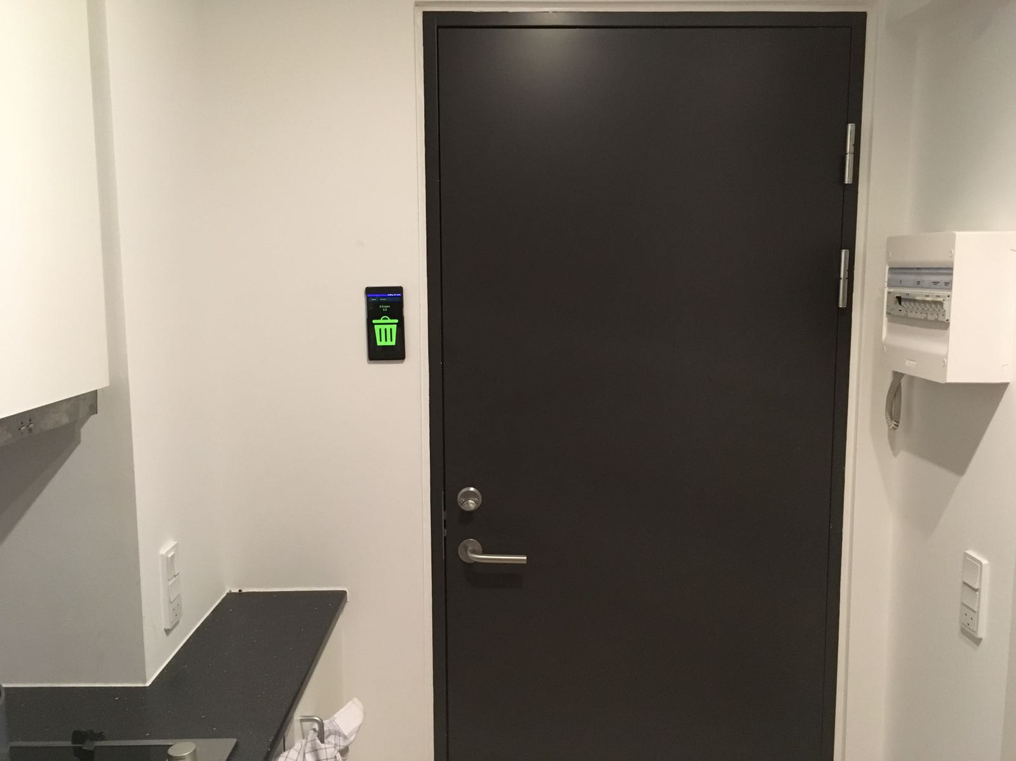
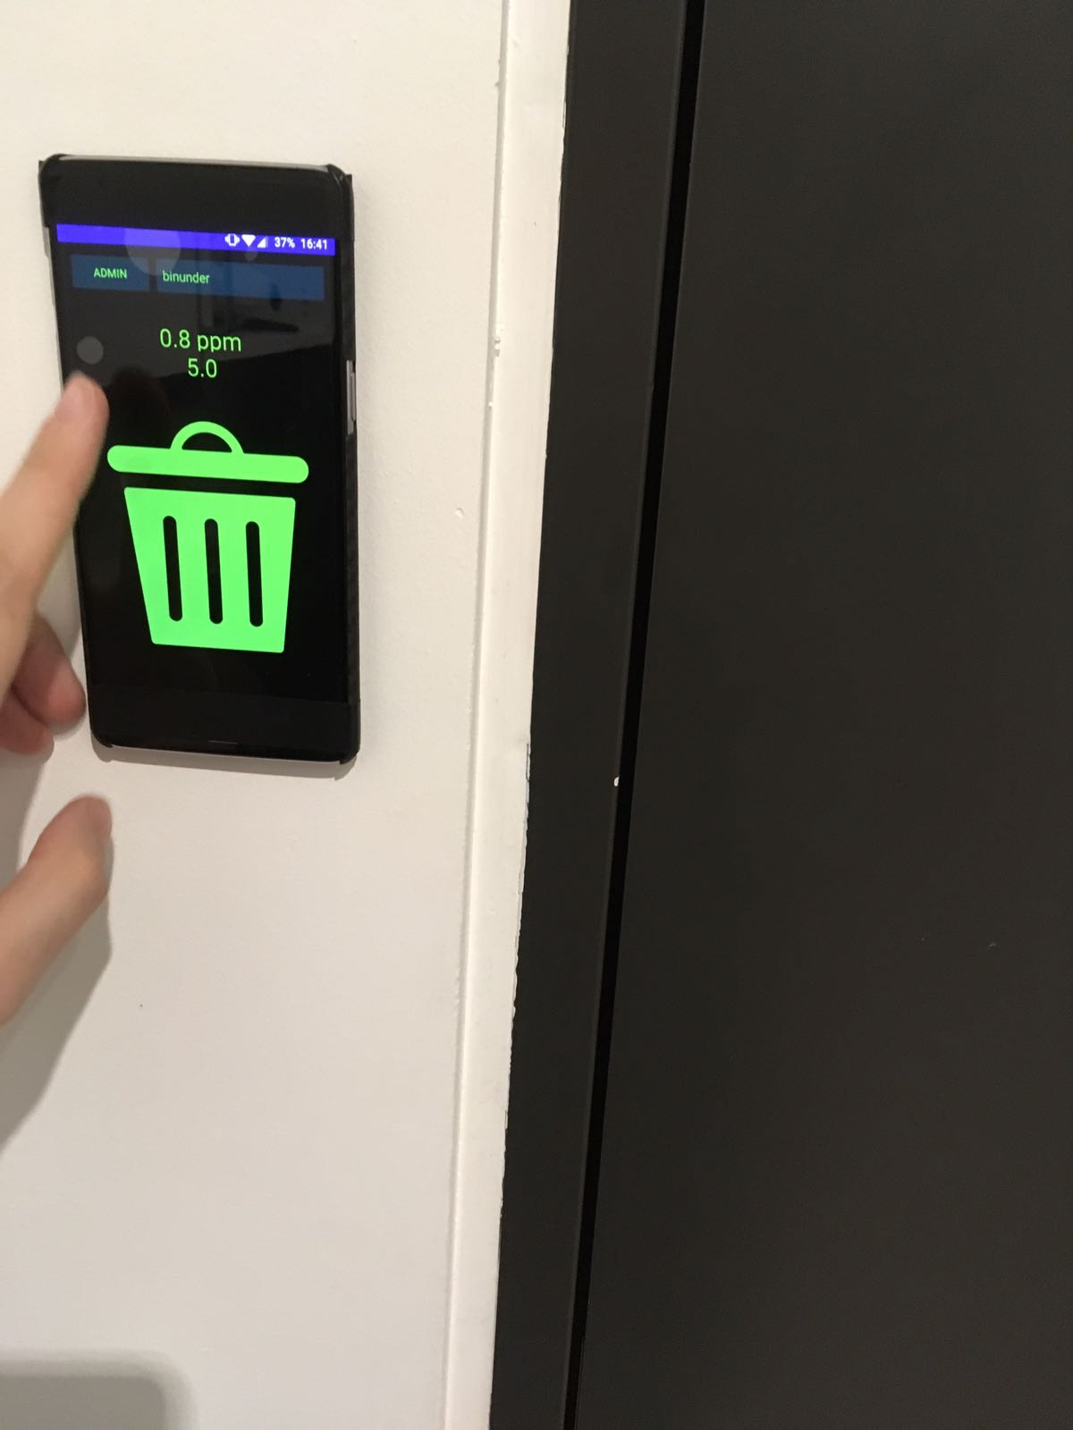
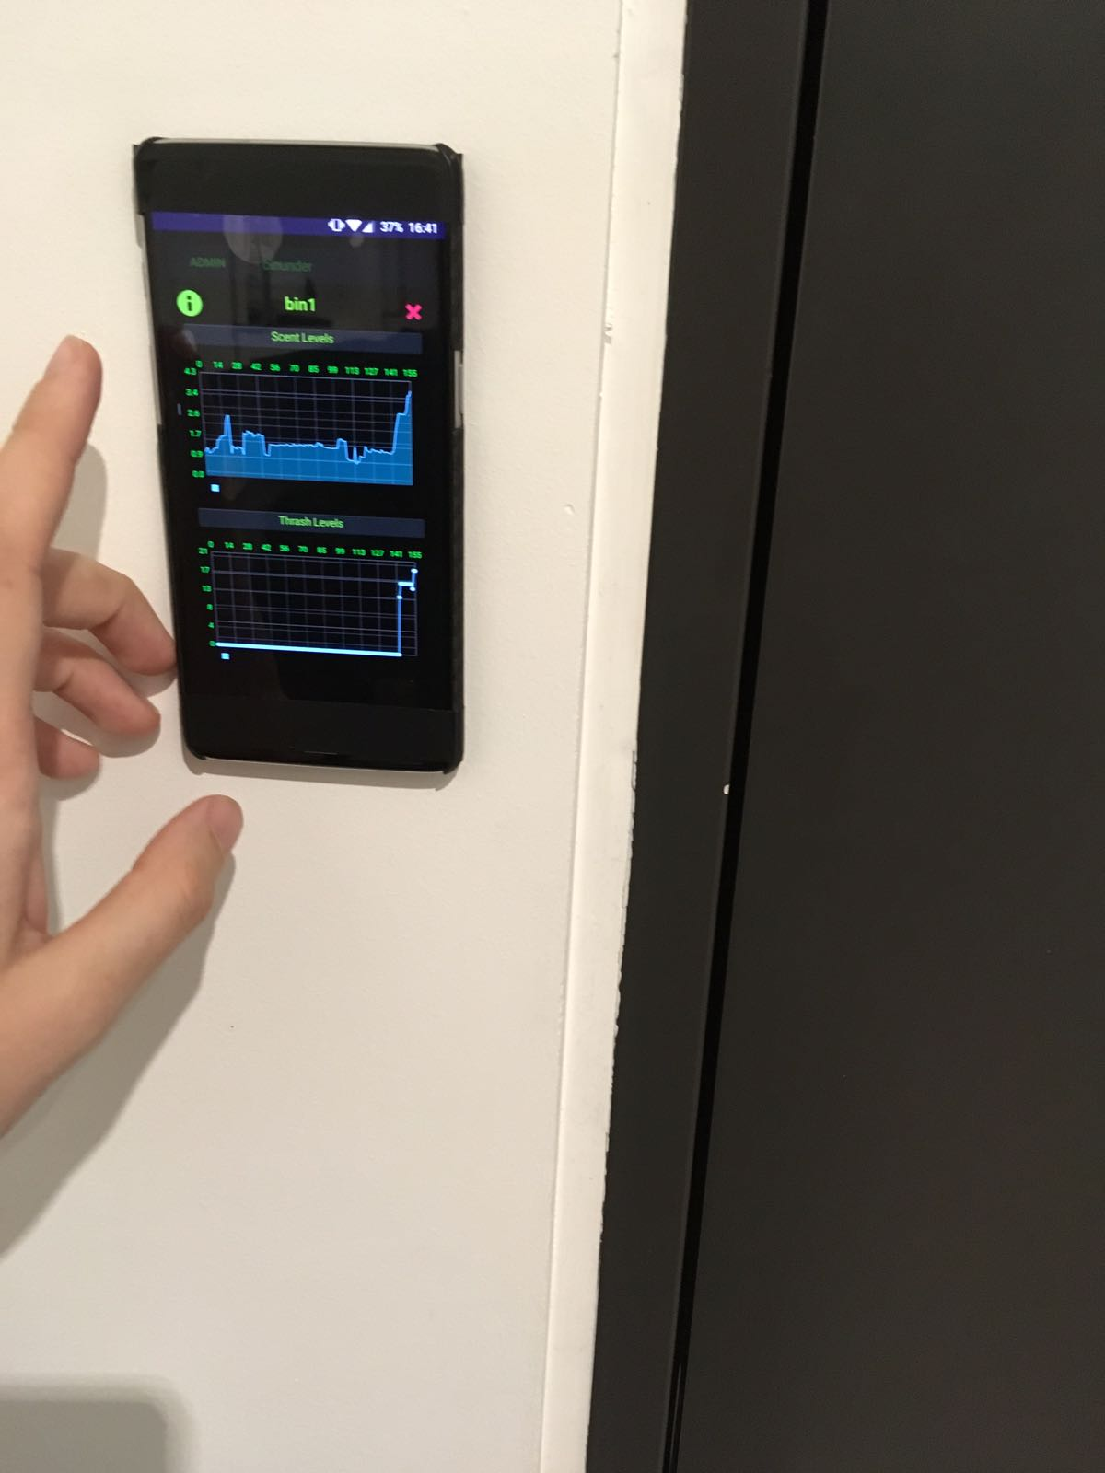
Ambient Display
The display is placed inside the home
The trash status is immediately visible from the color of the screen
Further interaction is possible by pressing on the screen and selecting the desired information

Slide 10
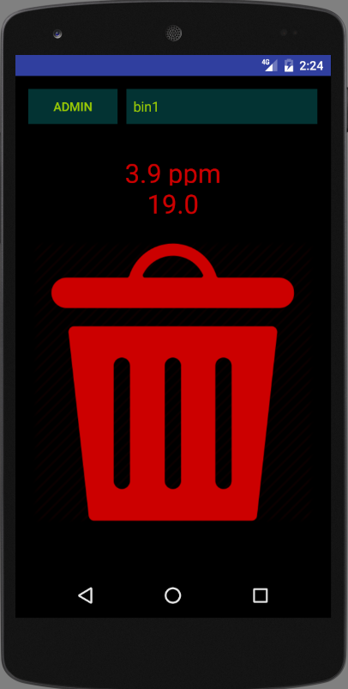
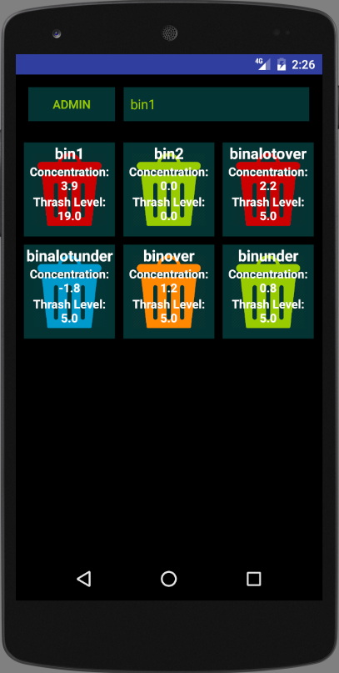
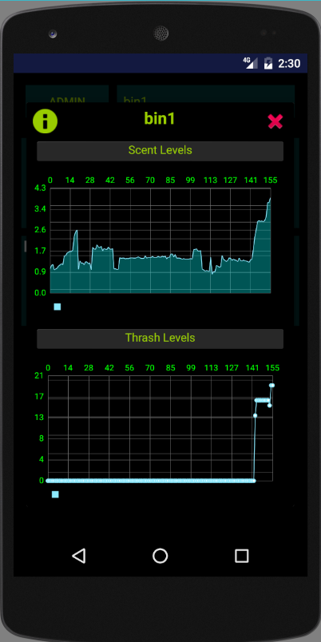
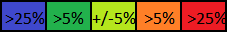
Android App
The smell level is represented by 5 colors
Also, smell level and trash height level are both on the screen.
It is possible to view the latest results, displayed as a graph of the latest data.

Slide 11
Conclusion
Smell can be accurately predicted by modern technology
Smell as a parameter is particularly relevant for indoor environments, but existing Waste Management Systems can be easily extended to contain it
Garbage collection could be driven by smell levels rather then/ in addition to trash amount

